Slide 5
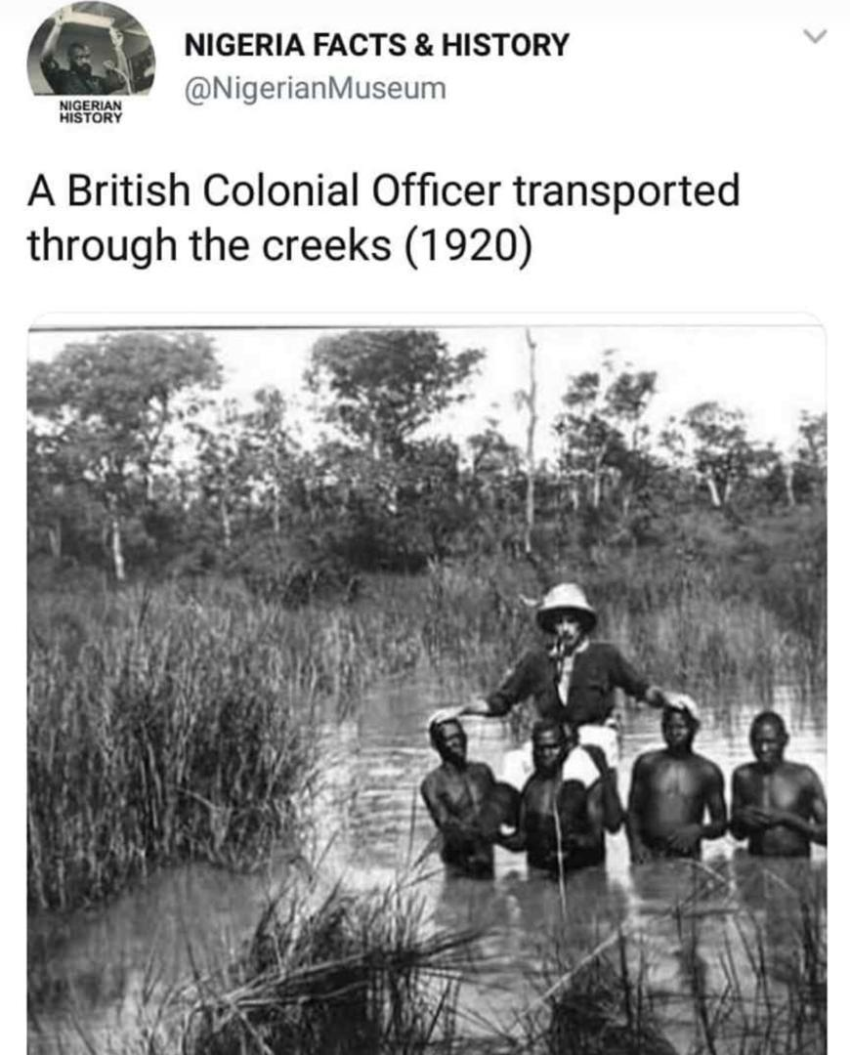
THE DISRUPTION OF DEVELOPMENT
Just as the environment is changing, the economy, the technology and the human resources are fast becoming diverse and swift in the changes. Interestingly, the taste of the traveler is increasing by the day just as diversity, smarter immigration services, globalization, digitalization are taking centre stage. The traveler is more INSATIABLE.

Slide 6
Jumia Hospitality Report, 2019

Slide 7
● Africa’s travel and tourism remains one of the key growth drivers of the continent’s economy, contributing 8.5% (or $194.2bn) of the GDP in 2018; from 8.1% and 7.8% in 2017 and 2016 respectively.
● This growth record placed Africa as the second-fastest growing tourism region in the world, with a growth of 5.6% in 2018 after Asia Pacific and against a 3.9% global average growth rate.
● In 2018, the continent received 67 million international tourist arrivals (+7% increase), as compared to 63 million in 2017 and 58 million in 2016. Africa received only 5% share of international arrivals in 2017.
Source- Jumia Hospitality Report, 2019

Slide 8
● The travel and tourism sector directly and indirectly provided employment for about 24.3 million people in 2018, accounting for approximately (6.7%) of total employment.
● In terms of room revenue, it is expected that in the next five years, Nigeria will be the fastest-growing market with a projected 12% compound annual increase. It will be followed by Tanzania and Kenya, with a projection of 8.2% and 7.4% compound annual increases respectively.

Slide 9
Guests in the accommodations generate demand and thus spending for activities, tours, food, beverages, handicrafts, the support services and ground transportation—all of which, of course, requires production and delivery.

Slide 10
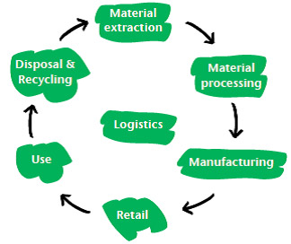
"Value chains are an integral part of strategic planning for many businesses today. A value chain refers to the full lifecycle of a product or process, including material sourcing, production, consumption and disposal/recycling processes.”
Source: WBCSD (2011)

Slide 11
SIMPLE VALUE CHAIN IN A BUSINESS
FROM CONCEPT TO COMPLETION,

Slide 12
“Supply chains and value chains have clear definitions in business literature and operational thinking. Where a supply chain typically refers to the chain of suppliers inputting to a final product, value chain also encompasses thinking about the value created by the chain, particularly for end-use customers…”- SustainAbility, UNEP and UNGC

Slide 13
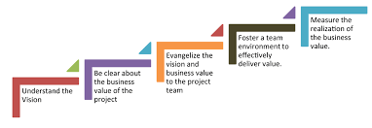

Slide 14
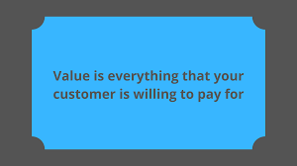

Slide 18
OPPORTUNITIES FOR INVESTMENT IN THE VALUE CHAIN
Hospitality and Tourism Consultancy (Specialization & Experiences Matters a lot)
Recruitment and Manpower Outsourcing
Training and Development PR
SALES & MARKETING
Tourism Brand identification, Management & Development
MEDIA- (Audio, TV, Prints)- ATQ Magazine; IHTEF Media
Food & Beverage Concepts
Food & Beverage Education/Development
Food & Beverage Management
Customer Service Specialists
Tour Operations- EG- Allure Travels, etc City Tours, Community Based Tours
Ticketing Services

Slide 19
VALUE CHAIN OF TOURISM-UNCHAINED
Tourism Statistics/Data Management
Tourism Funding Investment Opportunities- (Micro-finance banks or FINTECHs that offer Tourism focused lending)
IT/SUPPORT SERVICES
Home grown veggies/organic farming for Tourism Business Use.
Destination Management
Hospitality/Tourism Advocacy
Professional Operational Management and Business Optimization

Slide 20
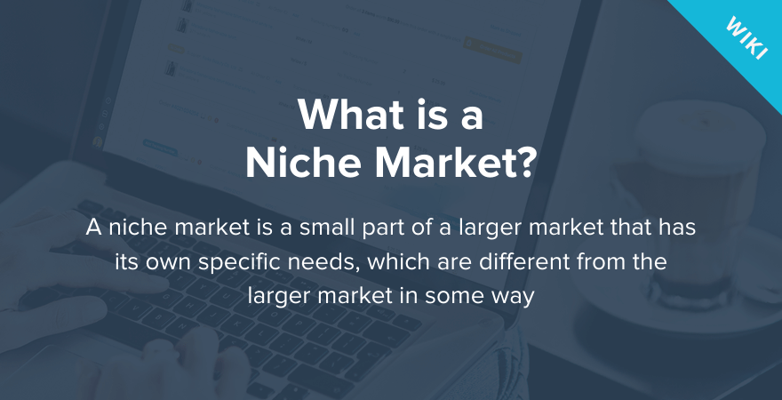
NICHE =NEST (Latin)
An environment that creates the best outcomes for your Ideal Customers, as well as the highest net profit for you

Slide 21
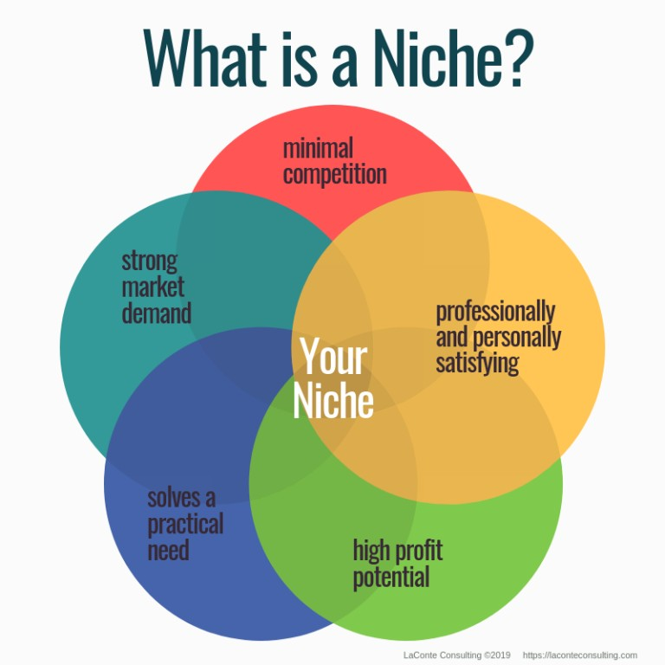

Slide 22
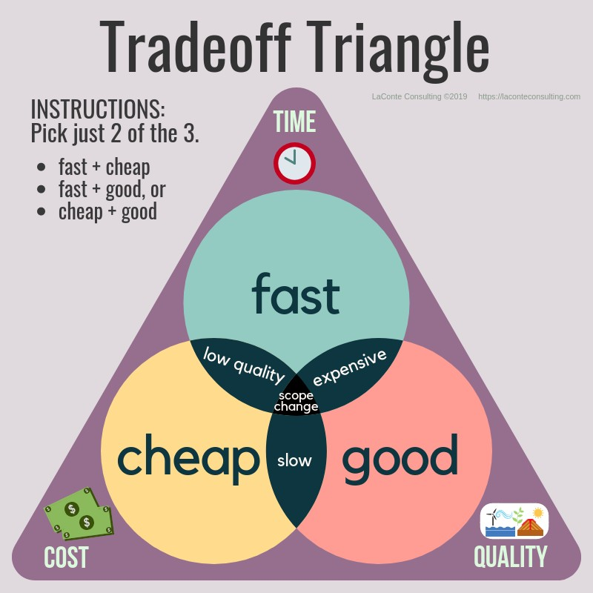

Slide 23
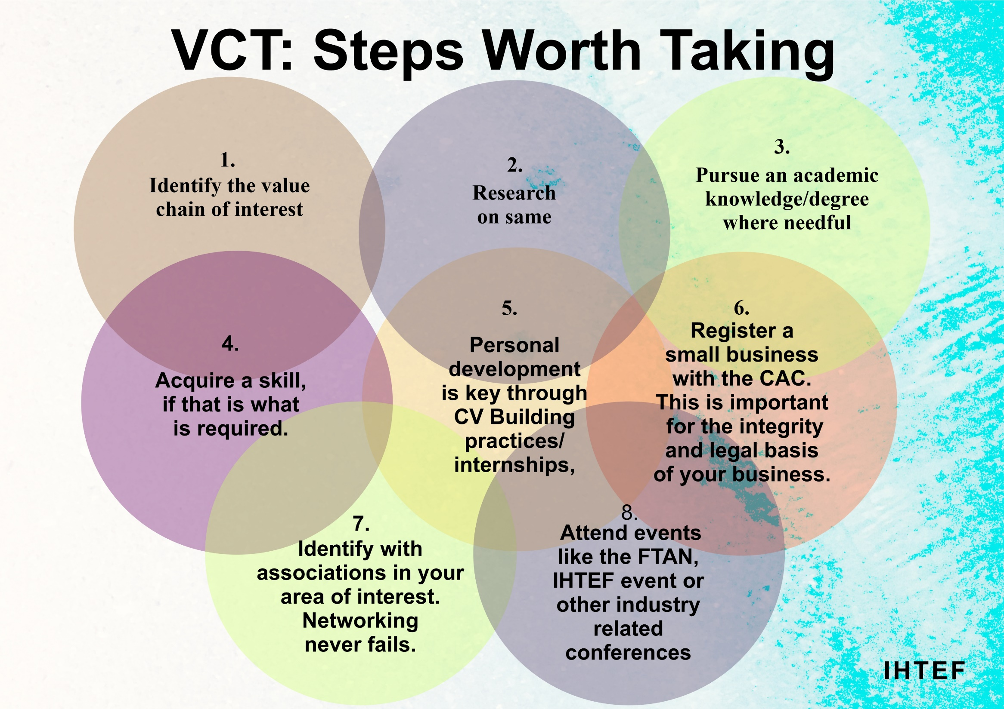

Slide 25
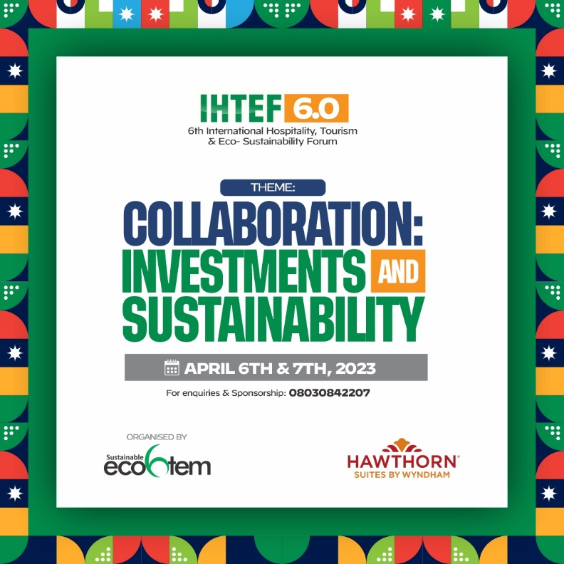

Slide 26
Value Chain of Tourism & Sustainability
We have enriched our minds with opportunities within the value chain of tourism. What then are other key
Value added roles that we have to play to ensure balance within the ecosystem and for sustainability purposes. This has to be from economic, environmental and from social dimensions.
Economic Value- For instance, operators, investors and tourism players must ensure that economic value from profits are retained within the region. Taking away everything and leaving mere footprints destroys the economy and livelihood of the region. Taxes are key. Sustenance is key.
Environmental Value- Tourism and Hospitality should renew the environment, not destroy. Tourism should be designed to add value by way of environmental protection. It is important to preserve the natural resources of a region – its landscape, vegetation
and biodiversity.
Socio-cultural- basically to generate value for the society. Value added must benefit host communities and members of these communities- bringing about improvements in systems and infrastructures; integrating the less privileged and the disabled into the value creation process.

Slide 29
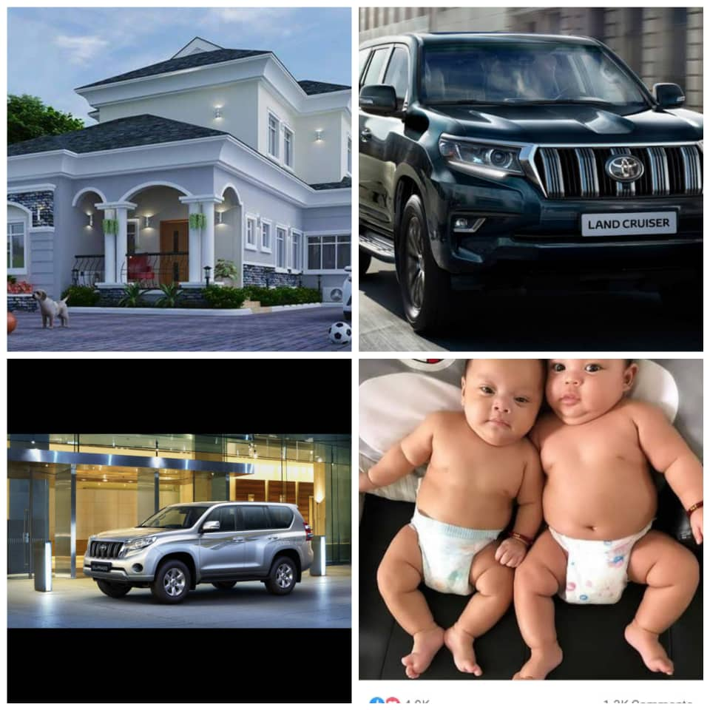

Slide 30
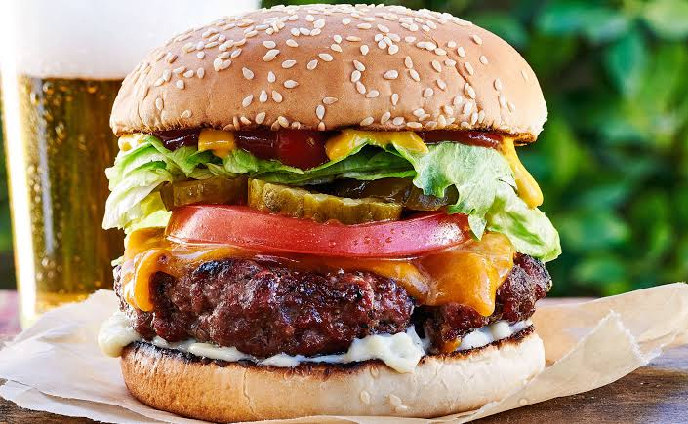
Thank you

Slide 32
HOTEL ONLINE REVIEWS

