Slide 1
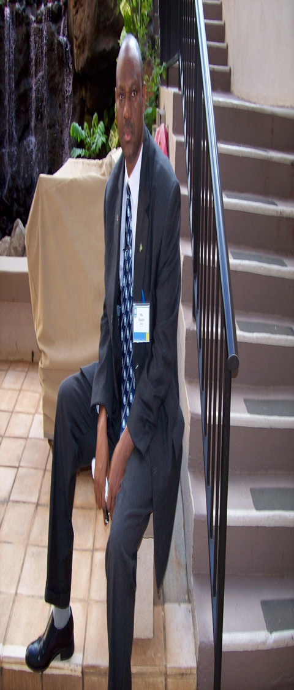
BUDGETING AND FUNDING: EFFECTIVE TOOLS FOR SUSTAINABLE TOURISM.
PMI
PRESENTED BY
PROF. PRINCE MIKE IKUPOLATI. AP
(BSC, MBA, PhD, DBA, LLB, FCII, FCIIN, FCIPDM, FNIM, FNIMN, FIMCN, FITD, DFPEFON, MIoD, CMC)
NATIONAL PRESIDENT AND CHAIRMAN OF THE GOVERNING COUNCIL, CHARTERED INSTITUTE OF PUBLIC DIPLOMACY AND MANAGEMENT
INTERNATIONAL CONSULTANT/CEO, GLOBAL INTELLECTUAL CONSULT LTD.
SUITE 318, 3RD FLOOR, MKK PLAZA, GUDU/ APO JUCTION, FCT, ABUJA,
2022

Slide 2

BUDGETING AND FUNDING TOURISM IN NIGERIA
PMI
“IF YOU DON’T TRAIN THEM, DON’T BLAME THEM,
AND
IF YOU THINK TRAINING IS EXPENSIVE, TRY IGNORANCE”

Slide 3
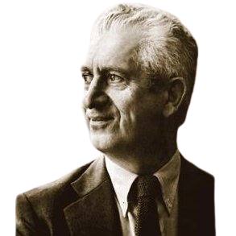
BUDGETING AND FUNDING TOURISM IN NIGERIA
PMI
Learning Outcomes
According to an Educational Psychologist – Benjamin Bloom, every Training Programme is directed at the Participants CAP.
CAP- Cognitive, Affective and Psychomotor Domains) so that their KAS can be improved:
Cognitive Domain - Knowledge
Affective Domain - Attitude
Psychomotor Domain - Skills

Slide 4

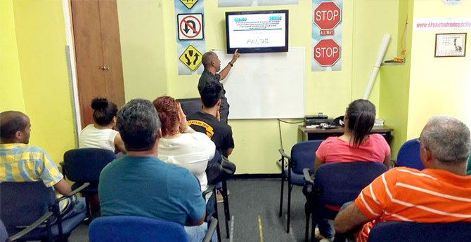
PMI
TEASER
THE STORY OF A PROFESSOR AND THE DRIVER.

Slide 5
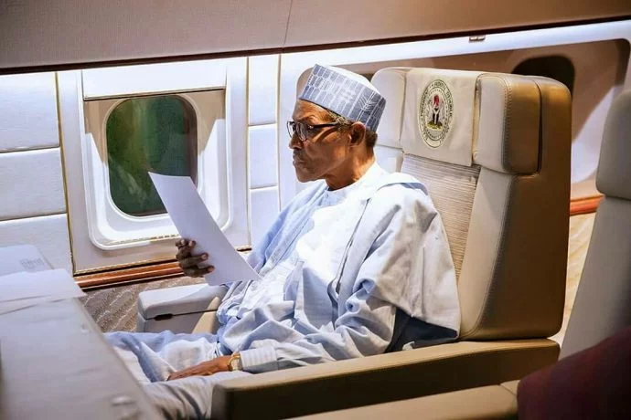
BUDGETING AND FUNDING TOURISM IN NIGERIA
PMI
Learning Outcomes
At the end of this session, Participants shall be able to:
define Tourism Development;
identify the impacts of Tourism;
appraise the roles of Tourism in National Development;
Assess the sources of funding Tourism development; and
demonstrate the ability to effectively handle issues of Tourism Development in Nigeria.

Slide 6
BUDGETING AND FUNDING TOURISM IN NIGERIA
INTRODUCTION

Slide 7

BUDGETING AND FUNDING TOURISM IN NIGERIA
Early man was nomadic and by definition his lifestyle involved travel. Generally the early mans wandering was confined to a clearly identifiable area, typically that in which he could hunt animal for food or food for his animals.
This type of nomadic lifestyle could not be termed tourism in any modern sense of the world.

Slide 8
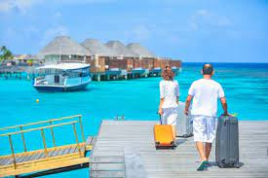
BUDGETING AND FUNDING TOURISM IN NIGERIA
Early man was nomadic and by definition his lifestyle involved travel. Generally the early mans wandering was confined to a clearly identifiable area, typically that in which he could hunt animal for food or food for his animals.

Slide 9
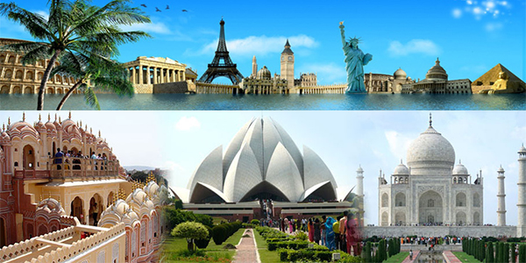
BUDGETING AND FUNDING TOURISM IN NIGERIA
This type of nomadic lifestyle could not be termed tourism in any modern sense of the world. Tourism presupposes a process of travel away from some form of home and a return to the home – until society were based around a ‘home’ tourism could not be said to exist.

Slide 10

BUDGETING AND FUNDING TOURISM IN NIGERIA
Early man did not simply either wander nomadically round a particular area or migrate in search of new pastures. Prof. Trevor Sofield of the University of Tasmania has argued on the Trinet discussion forum for tourism academics that:
‘’Australian Aboriginals engaged in ‘special animal events tourism’ when the nomadic barrels came together every year for a range of ceremonial activities and festivities as long as 30,000 years or more ‘’ Berndt and Berndt (1964).

Slide 11
BUDGETING AND FUNDING TOURISM IN NIGERIA
TOURISM DEFINED

Slide 12
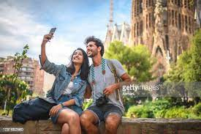
BUDGETING AND FUNDING TOURISM IN NIGERIA
Tourism Defined:
Tourism has been defined earlier by the League of Nations in 1937 as ‘’people travelling abroad for periods of over 24 hours’’. This definition can not suffice today.
The most widely accepted definition could be that of World Tourism Organization (WTO), the agency of the United Nations tasked with development and promoting tourism as ‘’the activities of persons traveling to and staying in place outside their usual environment for not more than one consecutive year for leisure, business or other purposes’’.

Slide 13
BUDGETING AND FUNDING TOURISM IN NIGERIA
By this definition pilgrimage clearly qualifies as tourism since it involves the temporary displacement of the pilgrimage, or religions tourist and him or her return home.

Slide 14
BUDGETING AND FUNDING TOURISM IN NIGERIA
MAIN IMPACTS OF TOURISM

Slide 15
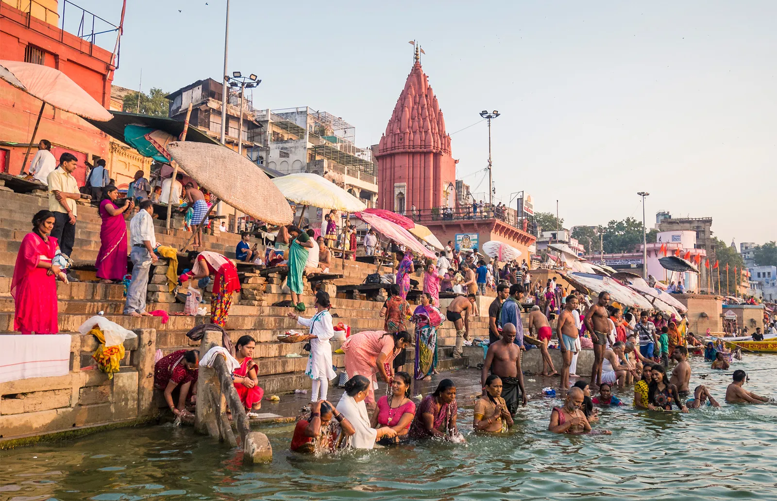
BUDGETING AND FUNDING TOURISM IN NIGERIA
MAIN IMPACTS OF TOURISM
  Economic Impacts – Jobs creation for local people, tourists spending has a multiplier effect both for the primary and secondary beneficiaries.
    Reduction of unemployment.
    Reduction of poverty level.
    Increase in number and volume of business of MSMEs.
    Value added Chains in local goods production.
    Increase creativity and innovation.
    Attracting foreign investments.

Slide 16
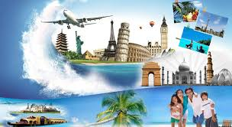
BUDGETING AND FUNDING TOURISM IN NIGERIA
Socio-cultural Impact – Tourists tend to behave in less inhibited ways when on holiday and this set a behavioral pattern which challenges the social norms of local people.
    Strengthened communities due to more money and resources
    Improved infrastructure including buildings and transports systems
    Higher rate of employment due to the tourism industry
    Improved understanding of different cultures and traditions
    Preservation of local culture
    Conservation of heritage including architecture and natural sits
    Increased number of events and celebrations.

Slide 17
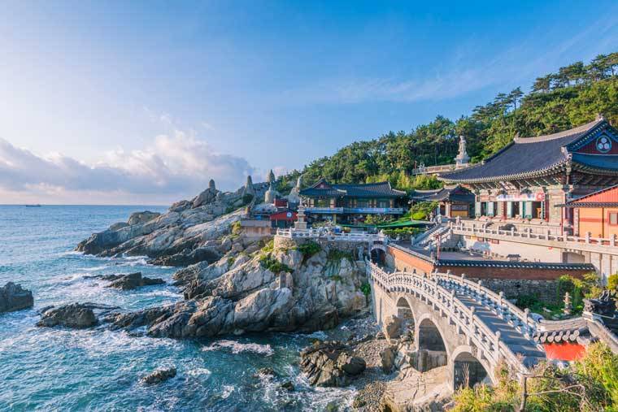
BUDGETING AND FUNDING TOURISM IN NIGERIA
Environmental Impacts – The continued presence of large numbers of tourists result in the degradation of the nature environment, through direct impact on the physical environment, inappropriate use of land and water resources and through putting excessive pressure on the built environment especially in the case of historical and cultural buildings. However, it could also lead to:
    Creation of natural parks and Areas of Outstanding Natural Beauty;
    Reduced numbers of animals poaching;
    Improved water quality; and
    Increased funding for nature conservation and protection.

Slide 18

BUDGETING AND FUNDING TOURISM IN NIGERIA
When these impacts are netted off, tourism process is sustainable at any particular destination and Nigeria can’t be an exemption.
Nigeria simply need to go back to the tourism drawing board and redesign our model of tourism promotion and development.

Slide 19
BUDGETING AND FUNDING TOURISM IN NIGERIA
CONDITIONS FOR SUSTAINABLE TOURISM IN NIGERIA

Slide 20
BUDGETING AND FUNDING TOURISM IN NIGERIA
PMI
INTERNATIONAL Tourism Revenue in Nigeria 2016 - 2020
YEAR | TOURISM ($) | COMMENT
2020 | 321,000,000.00, | 78.18% decline from 2019
2019 | 1,471,000,000.00 | 25.59% decline from 2018
2018 | 1,977,000,000.00 | 24.4% decline from 2017
2017 | 2,615,000,000.00 | 140.35% increase from 2016.
2016 | 1,863,199,145.00 | 24.74% increase from 2015

Slide 21
BUDGETING AND FUNDING TOURISM IN NIGERIA
PMI
Nigeria Tourism Statistics - Historical Data
Year | Spending ($) | % of Exports
2020 | 321,000,000.00 | 0.80
2019 | 1,471,000,000.00 | 2.10
2018 | 1,977,000,000.00 | 2.99
2017 | 2,615,000,000.00 | 5.14
2016 | 1,088,000,000.00 | 2.83

Slide 22
BUDGETING AND FUNDING TOURISM IN NIGERIA
PMI
Similar Country Ranking (2020)
Country Name | Spending ($)
Egypt | 4,874,000,000.00
Morocco | 4,514,000,000.00
Tunisia | 1,007,000,000.00
Cameroon | 437,000,000.00
Nigeria | 321,000,000.00

Slide 23


BUDGETING AND FUNDING TOURISM IN NIGERIA
PMI
So, what must we do in Nigeria to improve tourism performance?
  Sufficient leisure time – Nigerians are too busy to have adequate leisure time which reduces domestic tourism.
  Sufficient earnings to be able to spend money on holiday.
  Cheap and easy means of transportation,

Slide 24
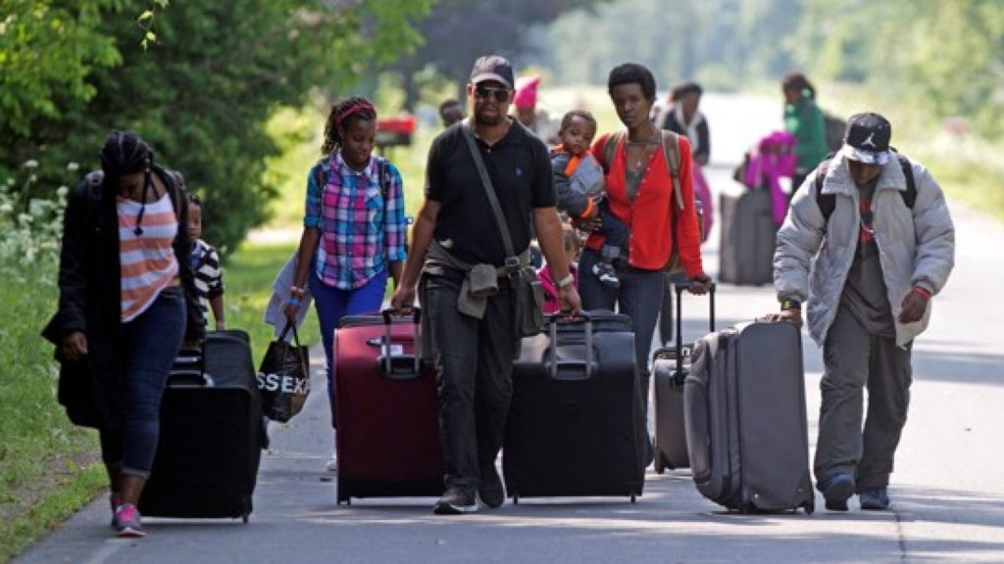
BUDGETING AND FUNDING TOURISM IN NIGERIA
PMI
Increase Commercial organizations producing and marketing tourism products.
Sufficient availability of tourism sites formally designated as such and improvement of the hospitality sector in Nigeria.
Adequate infrastructures to support memorable stay in Nigeria by foreign tourists. Good roads, Hospitals etc.

Slide 25

BUDGETING AND FUNDING TOURISM IN NIGERIA
PMI
Local authority commitment to tourism growth and development including empowering the tourism operators and improving retailing tourism in Nigeria.
Enabling laws and commitment to enforceability of the laws and tourism regulations in Nigeria.
Mass awareness for Nigerians especially MSMEs to take advantage of tourism opportunities in Nigeria.
Finally and most importantly, security of lives and properties of the tourists in Nigeria.

Slide 26
BUDGETING AND FUNDING TOURISM IN NIGERIA
GOALS OF SUSTAINABLE TOURISM

Slide 27
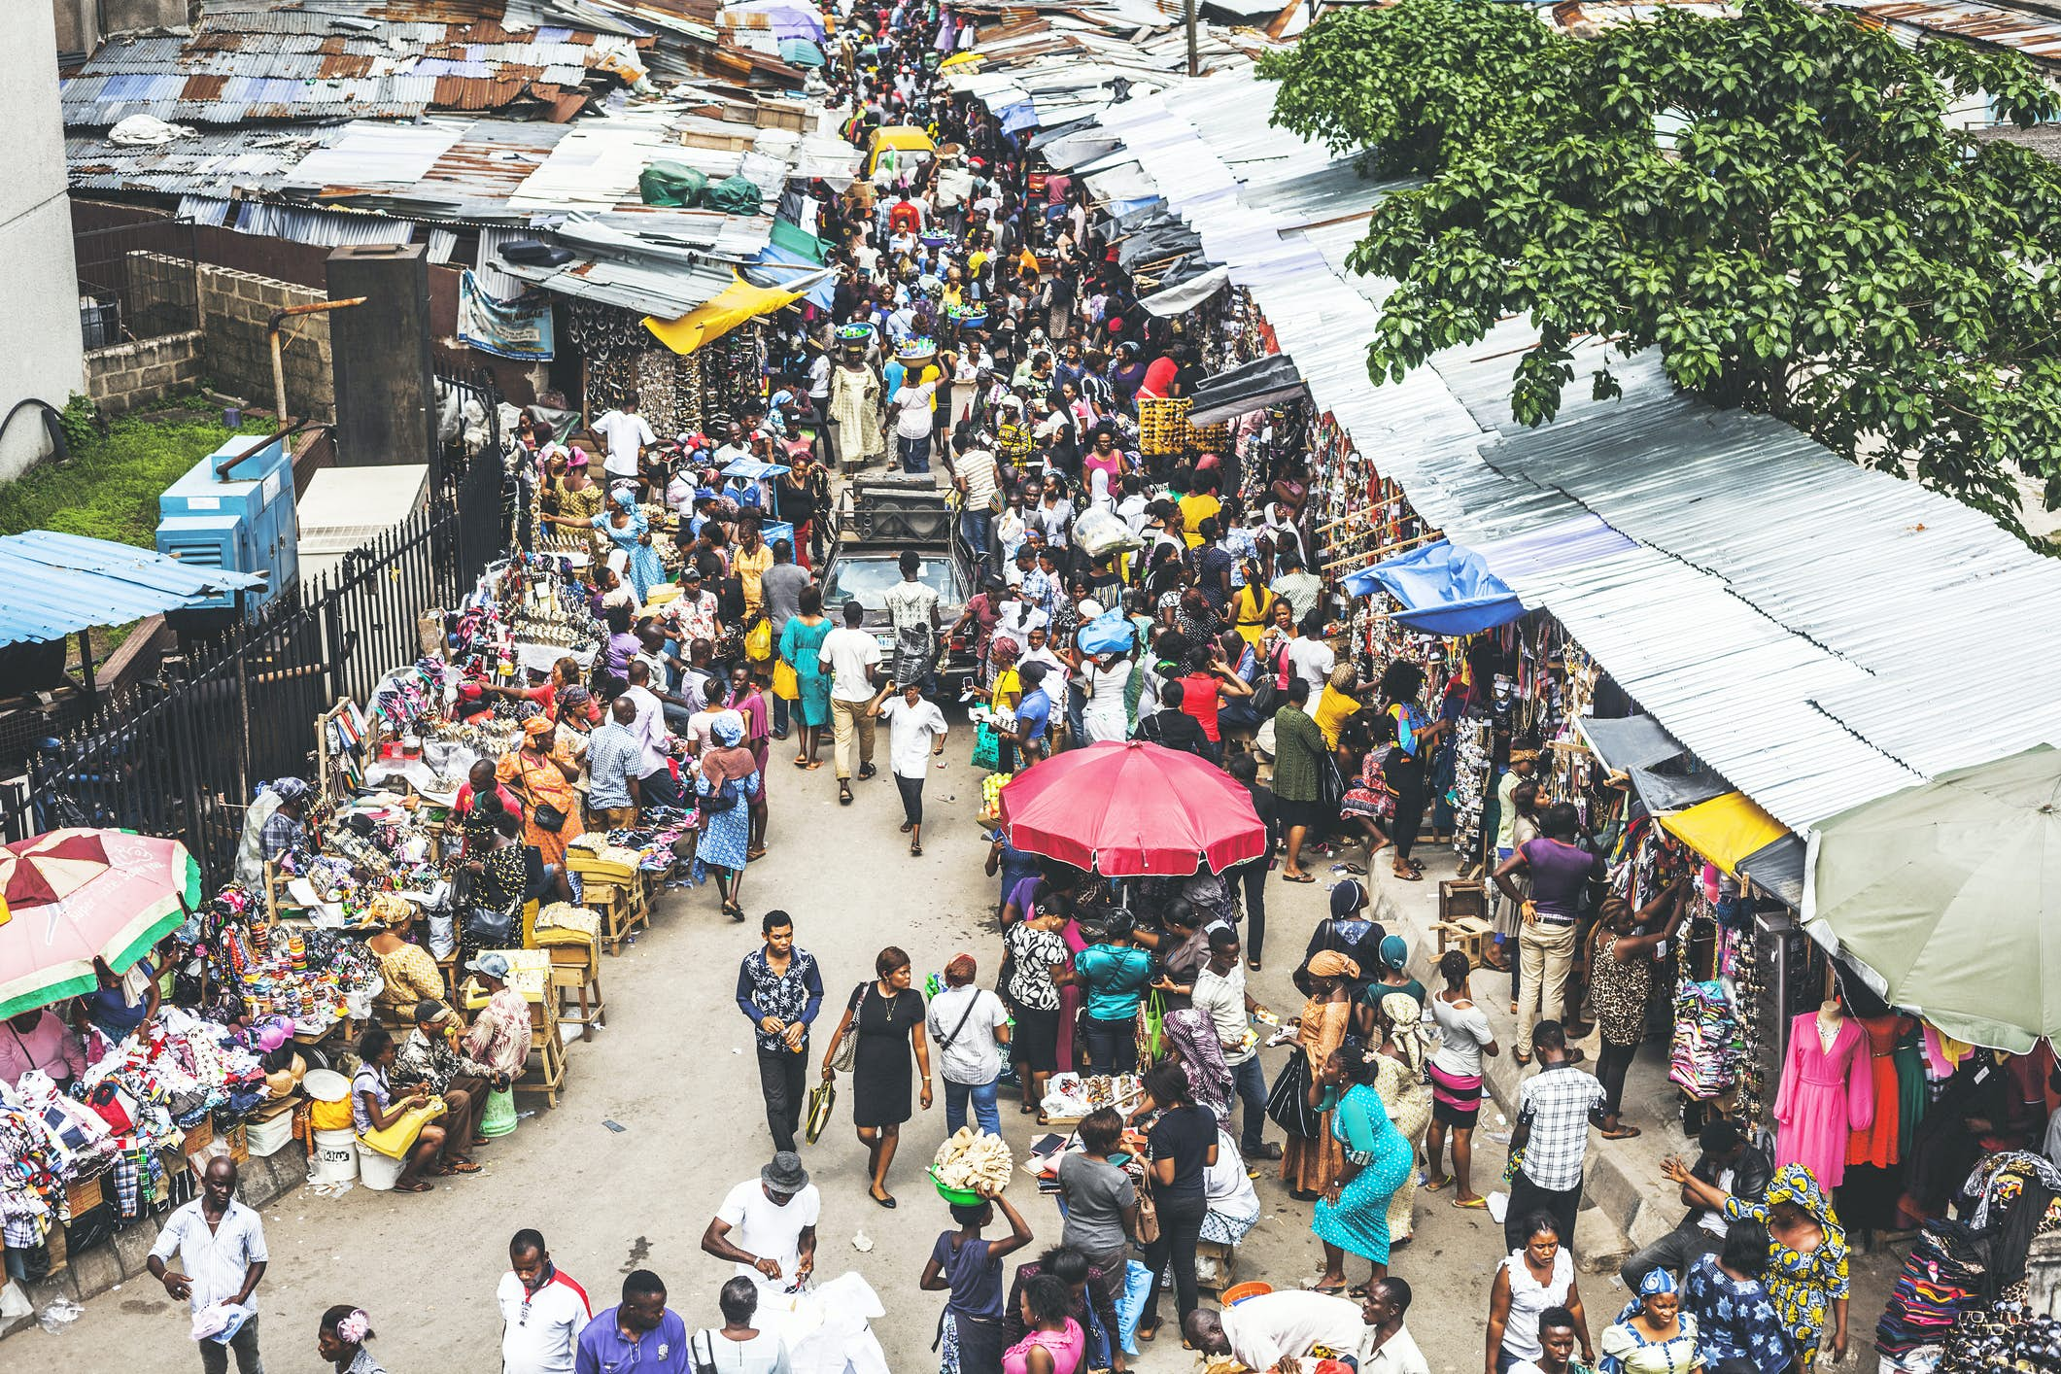
BUDGETING AND FUNDING TOURISM IN NIGERIA
PMI
How sustainable tourism is providing solution
  It’s not just local communities that live in tourist destinations that are feeling the negative effects of tourism. Tourist themselves, prefer to visit places that are clean, not too crowded, and safe.
  They also usually want to preserve local cultures, traditions, religions and buildings. Rather than experience an inauthentic ploy for money. Simmons D.G., (1994).

Slide 28
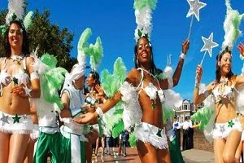
BUDGETING AND FUNDING TOURISM IN NIGERIA
PMI
  Therefore, we all have a lot to gain from alternative forms of tourism, including sustainable forms. The best places for sustainable tourism to be developed are regions with natural resources, landscapes or cultural buildings – all features that attract tourists who might want to explore and admire local destination and cultures in an environmentally friendly way. Smith, S.l.J., (1994).

Slide 29
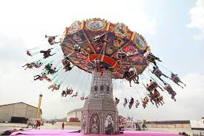
BUDGETING AND FUNDING TOURISM IN NIGERIA
PMI
The goals of sustainable tourism
The World Tourism Organization and the United Nations Environment Program suggested twelve main goals for sustainable tourism in 2005.
These will help to demonstrate the ways in which sustainable tourism can provide a solution to some of the global challenges facing the industry in Nigeria today.

Slide 30
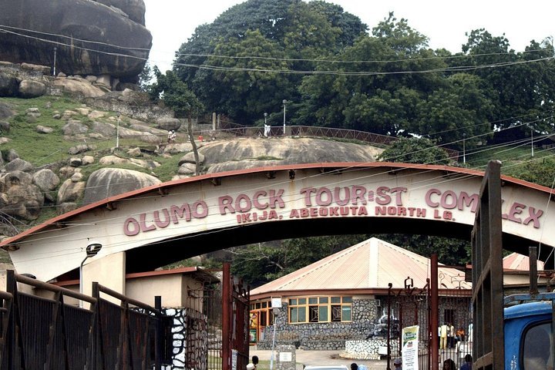
BUDGETING AND FUNDING TOURISM IN NIGERIA
PMI
Economic Viability: To make sure that tourism destinations and businesses are viable, competitive, and able to achieve long-term success.
Local Prosperity: To ensure that tourism activities help local communities thrive economically and retain a large amount of the economic contribution.
Employment Quality: To increase the number of local jobs created in the tourism industry and ensure that the pay and working conditions are fair, safe and offered to workers without discrimination.

Slide 31
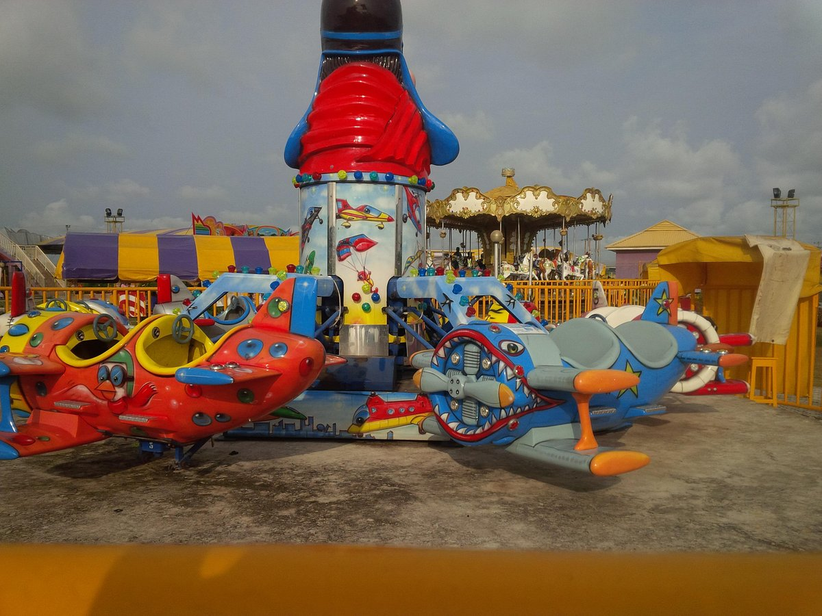
BUDGETING AND FUNDING TOURISM IN NIGERIA
PMI
Social Equity: To ensure that tourism increases the amount of economic and social benefits being distributed across local communities, improving all areas of life.
Visitor Fulfillment: To create a safe and fulfilling holiday experience for tourists without discrimination based on race, gender, sexuality, disability or others.
Local Control: To empower local communities to have a role in planning and decision-making regarding tourism in their neighborhoods.

Slide 32
BUDGETING AND FUNDING TOURISM IN NIGERIA
PMI
Community Wellbeing: To improve the quality of life and wellbeing of local communities ensuring they have access to resources and are not disrespected or exploited in the name of tourism.
Cultural Richness: To respect the cultural heritage, traditions, authenticity and uniqueness of host communities.
Physical Integrity: To look after all landscapes, whether urban or rural, and ensure that they are not degraded physically or visually due to tourism.

Slide 33
BUDGETING AND FUNDING TOURISM IN NIGERIA
PMI
Biological Diversity: to conserve natural areas, wildlife, and unique habitats protecting them and ensuring they are not damaged.
Resources Efficiency: To use sustainable and renewable resources when possible in the development and operation of tourism facilities and services.
Environmental Purity: To Protect the land, air and water from pollution, littering and other waste that may come as a result of tourism business or visitors.

Slide 34
BUDGETING AND FUNDING TOURISM IN NIGERIA
BUDGETING IN TOURISM

Slide 35

BUDGETING AND FUNDING TOURISM IN NIGERIA
PMI
What is budgeting?
Budgeting is the process of creating a plan to spend money.
This spending plan is called a budget.
Creating this spending plan allows Government or organizations to determine in advance whether they will have enough money to do the things they need to do or would like to do.
Budgeting is therefore simply balancing expenditures with incomes.

Slide 36
BUDGETING AND FUNDING TOURISM IN NIGERIA
PMI
There are four common types of budgets that can be used in Tourism:
    incremental,
    activity-based,
    value proposition, and
    zero-based.
In Tourism Budget is important to:
    The Government;
    The DMO,DMCs and other stakeholders; and
    The Tourists.

Slide 37
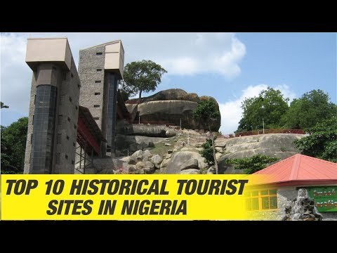
BUDGETING AND FUNDING TOURISM IN NIGERIA
PMI
GOVERNMENT BUDGET ON TOURISM.
Nigeria recorded a total of five million tourists in 2021, ranking 35th in the world in absolute terms.
The fact that larger countries regularly perform better in a comparison of the absolute number of guests is obvious.
By putting the tourist numbers in relation to the population of Nigeria, the result is much more comparable picture: With 0.025 tourists per resident, Nigeria ranked 164th in the world. In Western Africa, it ranked 8th.

Slide 38
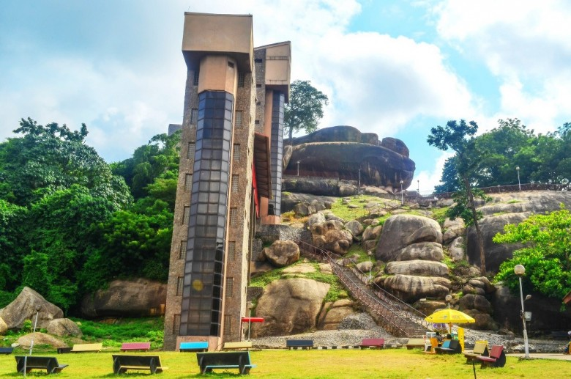
BUDGETING AND FUNDING TOURISM IN NIGERIA
PMI
Nigeria generated around 321.00 million US Dollar in the tourism sector alone.
This corresponds to 0.073 percent of its the gross domestic product and approximately 34 percent of all international tourism receipts in Western Africa.
Government budget on Tourism in Nigeria has been at a very low level in the last decade, compared to countries like Kenya, Egypt, South Africa and even The Gambia.

Slide 39
BUDGETING AND FUNDING TOURISM IN NIGERIA
PMI
  As a result Tourism contribute about 2% on the average to DGP during this period.
  75% of Government budget to Tourism in Nigeria is spent on recurrent expenditures.
  About 3,5% of DGP that went to Government intervention did not come to private tourism.
Can this be the ultimate potential of Nigeria in Tourism? No!
  Government should therefore increasing funding to tourism agencies and rejig their operations.
  Government must invest in tourism Brand development and Digital Tourism in Nigeria.

Slide 40
BUDGETING AND FUNDING TOURISM IN NIGERIA
PMI
What is a DMO?
The DMO meaning or Destination Marketing Organization is a not-for-profit organization that represents a specific destination. Its purpose is to help drive business to the destination through group bookings at area properties.
What is a DMC?
DMC’s specialize in the implementation of events rather than the destination and hotel selection. They handle all aspects of a program from airport transportation to themed events, activities and tours to overall program logistics. DMC’s are for profit businesses, providing services for a fee.

Slide 41
BUDGETING AND FUNDING TOURISM IN NIGERIA
PMI
There are three important activities of a DMO namely:
  coordination of tourism stakeholders,
  destination crisis management, providing oversight of the system through the implementation and management of the program, and
  destination marketing, spearheading the DMO component.

Slide 42
BUDGETING AND FUNDING TOURISM IN NIGERIA
PMI
DMO Budget Analysis - provides a fact- based, compelling evaluation of current competitiveness and the economic opportunity associated with the budget funding of destination marketing.
DMO Budgets are benchmarked against known measurements for each destination, including:
    Hotel room revenue
    Leisure and hospitality employment
    Leisure and hospitality income
    Bed Tax Rates.

Slide 43
BUDGETING AND FUNDING TOURISM IN NIGERIA
PMI
Various competitive sets and indicator combinations are explored to identify those that best highlight the current situation.
Based on the findings of the competitive benchmarking analysis, Tourism Economics identifies an optimal budget to enable a DMO to compete both domestically and internationally.
Tourism Economics will make recommendations on funding levels based on quantitative analysis.

Slide 44
BUDGETING AND FUNDING TOURISM IN NIGERIA
PMI
Economic rationale for destination marketing:
This analysis describes:
  the competitive nature of tourism,
  the perishability of the product, seasonality,
  the value of scale, and
  the importance of brand development.
In all these areas, a case is built for why destination promotion is an essential part of fostering the economic value of the tourism sector in the state.

Slide 45
BUDGETING AND FUNDING TOURISM IN NIGERIA
PMI
This is based on a combination of economic theory, statistical analysis, and case studies.
Recent Tourism Economics research on how destination marketing drives broader economic development is used as references to buttress the case for competitive funding.
When the rationale is defined, the Tourism Economics team presents both positive and negative case studies of when destination marketing has been well-funded and defunded.

Slide 46
BUDGETING AND FUNDING TOURISM IN NIGERIA
PMI
The iconic “Colorado story” as well as the more recent “San Diego story” authored by Adam Sacks of Tourism Economics provide cautionary tales of what happens to market share when destination marketing is defunded.
More recent case studies are included.
Key performance indicators (KPIs) are also leveraged in building the case for the economic benefits of destination marketing investments.

Slide 47
BUDGETING AND FUNDING TOURISM IN NIGERIA
PMI
Track competitiveness over time:
  An analysis of a DMO’s tourism sector performance relative to the nation and its competitive set, which is defined in consultation with the client. Losses in market share, and the parallel effect on room nights, are calculated over the past five years.
  Room demand, room revenue, leisure and hospitality employment and wages are tracked over the past ten years to determine the extent to which a destination are competing (or not) in the tourism market

Slide 48
BUDGETING AND FUNDING TOURISM IN NIGERIA
PMI
Conduct scenario impact analysis:
The last phase of work produces a calculation the potential benefits of increasing the marketing budget to be in line with its competitive set.
Impacts are measured in terms of visits, business sales, jobs, income, and tax generation.
Incremental visits, room nights, and spending that would be realized through investing more in destination marketing are calculated using a combination of case studies and historic KPIs.

Slide 49
BUDGETING AND FUNDING TOURISM IN NIGERIA
PMI
The IMPLAN economic impact model for the region is used to calculate direct, indirect, and induced impacts by industry sector.
IMPLAN is an input-output model that measures the relationships between and among industries and consumers.
For example, the model tracks the flow of a visitor’s restaurant expenditures to wages, profits, capital, taxes and suppliers.

Slide 50

BUDGETING AND FUNDING TOURISM IN NIGERIA
PMI
The supplier chain is also traced to food wholesalers, to farmers, and so on. In this way, the model allows for the measurement of the direct and indirect sales generated by a restaurant meal, for example.
The model also calculates the induced impacts of tourism. These induced impacts represent benefits to the economy as employees of tourism sectors spend their wages in the local economy, generating additional output, jobs, taxes, and wages.

Slide 51
BUDGETING AND FUNDING TOURISM IN NIGERIA
PMI
Economic impacts are measured on three levels:
  Direct
  Indirect
  Induced
The results of the analysis are typically shown for two scenarios, including:
    a “do nothing” scenario and
    funding scenarios over the next five years, to be defined in coordination with the client.

Slide 52
BUDGETING AND FUNDING TOURISM IN NIGERIA
PMI
BUDGET TRAVELLERS
Budget travel is travel that is cost-conscious and price-aware.
A budget traveler is someone who travels usually finding cheap flight tickets, low-cost accommodations, wallet-friendly food, and free or cheap tourist attractions to visit while there.

Slide 53
BUDGETING AND FUNDING TOURISM IN NIGERIA
PMI
Why is budgeting important for travel?
  The less money you spend, the longer you can travel for.
  It's that simple. Having to budget and make your money stretch usually means you can keep going!
  It also means you travel slower, as you spend more time in one city and use buses and trains: so you get to see more of one country as you travel through it.

Slide 54
BUDGETING AND FUNDING TOURISM IN NIGERIA
PMI
HOW TO TRAVEL ON A BUDGET.
Be open to alternative budget-friendly destinations;
Determine the most cost effective medium of travel;
Plan ahead of time and be flexible with your schedule;
Travel to a familiar location
Browse reasonable accommodation alternatives;
Try local food over eating in restaurants.
Make use of money-saving apps (Travelspend, tripIt Apps) Available on: Both Apple App Store and Google Play Store;
Consider going local
Travel in groups – The more the merrier
Spend less time shopping and more time making memories.

Slide 55
BUDGETING AND FUNDING TOURISM IN NIGERIA
FINANCING TOURISM IN NIGERIA

Slide 56
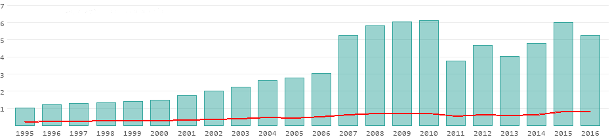
BUDGETING AND FUNDING TOURISM IN NIGERIA
PMI
Data in the chart are given in millions of tourists. The red line represents the average of all 15 countries in Western Africa.

Slide 57
BUDGETING AND FUNDING TOURISM IN NIGERIA
PMI
M
Year | Number of tourists | Receipts | % of GNP | Receipts per tourist
2016 | 5.27 m | 1.09 bn $ | 0.27 % | 207 $
2015 | 6.02 m | 461.00 m $ | 0.095 % | 77 $
2014 | 4.80 m | 605.00 m $ | 0.11 % | 126 $
2013 | 4.04 m | 616.00 m $ | 0.12 % | 153 $
2012 | 4.67 m | 638.00 m $ | 0.14 % | 137 $

Slide 58
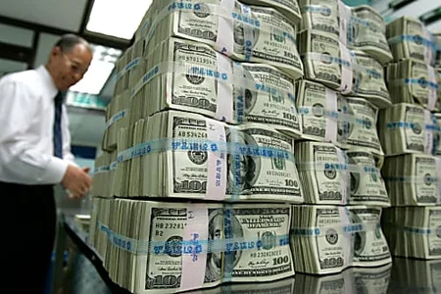
BUDGETING AND FUNDING TOURISM IN NIGERIA
PMI
Based on the previous theoretical experiences and knowledge related to the development aspects of the tourism economy, it can be concluded that the basic sources of financing all major projects in the tourism economy are;
    Share Capital (Action-Equity Capital)
    Loan Capital
      Investment Loans
      Mortgage Loans
      Long-term Loans

Slide 59
BUDGETING AND FUNDING TOURISM IN NIGERIA
PMI
Financing Investments in Tourism
    Self financing
    Crediting
    Joint ventures
    The issuance of securities
    Leasing
Tourism Financiers include:
    Individuals
    Business entities
    State Institutions and organizations
    Insurance and Banking Institutions
    NGOs

Slide 60
BUDGETING AND FUNDING TOURISM IN NIGERIA
PMI
Main players in tourism financing are:
  Project sponsors (A private company, Business Consortium or Host Government)
Project financiers can be;
    Companies
    Investment funds
    International Development and Investment banks
    Insurance companies
    Equipment manufacturers
    Pension funds
    Future consumers.

Slide 61
BUDGETING AND FUNDING TOURISM IN NIGERIA
PMI
Financing from Loan;
    Secured Debentures
    Unsecured Debentures
    Letter of credit
    Guarantee (Bank or Insurance Policy Guarantee)
Financing through the issuance of securities (shares) co-owners of the tourism projects.
Internal recapitalization: (Right issues)

Slide 62
BUDGETING AND FUNDING TOURISM IN NIGERIA
PMI
Areas of Financing in Tourism
Some of the important aspect of financing and budgeting in relation to tourism management include;
  Travel.
  Transport.
  Accommodation.
  Provision of food and beverage.
  Tourist Guide and Entertainment.
  Capacity building for tourism stakeholders
  Sites development.

Slide 63
BUDGETING AND FUNDING TOURISM IN NIGERIA
PMI
These are carefully analyzed in terms of cost, volume and profit analyses to determine their commercial viability.
Tourism costs are mainly fixed costs which do not vary with the number of tourists.
The tourism service are perishable which means they cannot be stored or kept until later date e.g if a hotel room is not occupied over a night, the sales of the room for that night is lost forever.
Tourism therefore requires revenue maximization per time.

Slide 64
BUDGETING AND FUNDING TOURISM IN NIGERIA
PMI
Tourism also involves scaling larger scaled operators profit more than smaller operators. Hence business expansion is a crucial factor for tourism success.
In tourism industry, businesses that are linked by the type of services they provide and the customers they serve are horizontally integrated.

Slide 65
BUDGETING AND FUNDING TOURISM IN NIGERIA
EQUITY Vs. LOAN CAPITAL IN TOURISM FINANCING

Slide 66
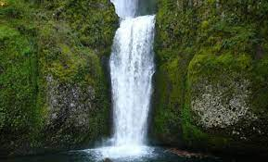
BUDGETING AND FUNDING TOURISM IN NIGERIA
PMI
DIFFERENCES BETWEEN FINANCING FROM EQUITY CAPITAL AND LOANS:
When financing the accommodation offer, it is important to compare and contrast equity capital and loans as two primary sources of financing. Various authors have analyzed them and stated major differences as follows (Vučurević, 2013):

Slide 67
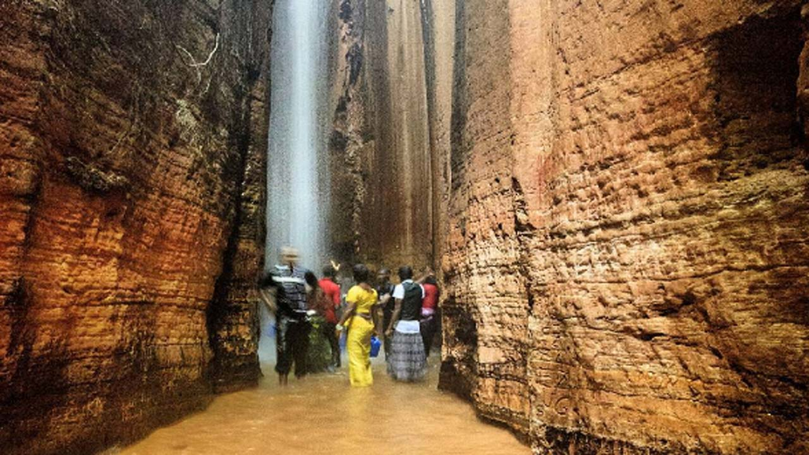
BUDGETING AND FUNDING TOURISM IN NIGERIA
PMI
Equity capital (share capital) entitles the holder to ownership interest and as such, the holder has a right to a vote. Loan capital, on the other hand, means crediting partnership; therefore, the investor (creditor) only has a right to payment;
Financing from loans is limited in time by the payment due date, upon which the principal amount is repaid and the loan is liquidated. Contrary to that, equity capital is timeless, or as durable as the shareholder is in possession of the stocks, until the holder decides to sell them in the secondary market or the company is liquidated;

Slide 68
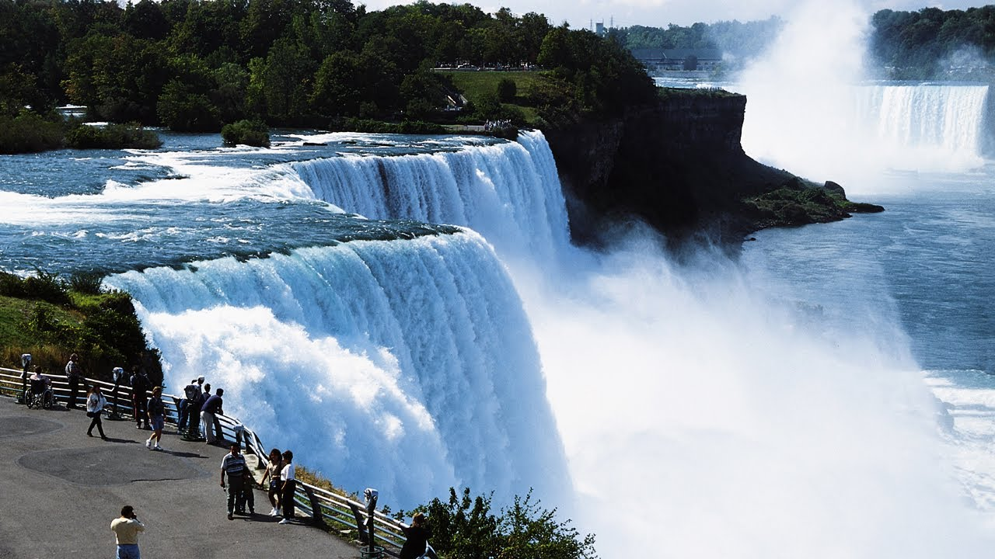
BUDGETING AND FUNDING TOURISM IN NIGERIA
PMI
Unlike, creditor status within the company, the shareholder has a right to a vote (controlling interest) because they are partial owners of the company with allocated risk;
In case of bankruptcy, the creditors have a right of the first offer, meaning they are repaid first.
The shareholders get repaid, if there are any funds left;

Slide 69
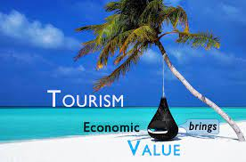
BUDGETING AND FUNDING TOURISM IN NIGERIA
PMI
Another difference is reflected in the repayment obligation. Companies are obligated to repay principal and interest to their investors and creditors as stipulated in the financing agreement, regardless of the company profits.
On the other hand, paying dividends to the shareholders depends on the profits of the company;

Slide 70
BUDGETING AND FUNDING TOURISM IN NIGERIA
PMI
There is also a considerable difference in the risk profit ratio. Shares of the company carry greater risk, hence they bring greater profits.
Dividend income and capital gains from shares depend on their price on the secondary market;

Slide 71
BUDGETING AND FUNDING TOURISM IN NIGERIA
PMI
Finally, the tax obligations are different. Tax on issued shares is considered as expenditure for the company. The amount is deducted from the net profits. On the other hands, payments to investors and creditors are done from the net profit which is already taxed.
Therefore, financing from loans is cheaper than from equity capital.

Slide 72
BUDGETING AND FUNDING TOURISM IN NIGERIA
BUDGETING AND FUNDING AS TOOLS OF SUSTAINABLE TOURISM

Slide 73

BUDGETING AND FUNDING TOURISM IN NIGERIA
PMI
The of cockroach in the restaurant
Reacting to situations in the Tourism sector will not help the Country.
The Government, Organizations and individuals must begin to respond to tourism challenges in Nigeria.

Slide 74
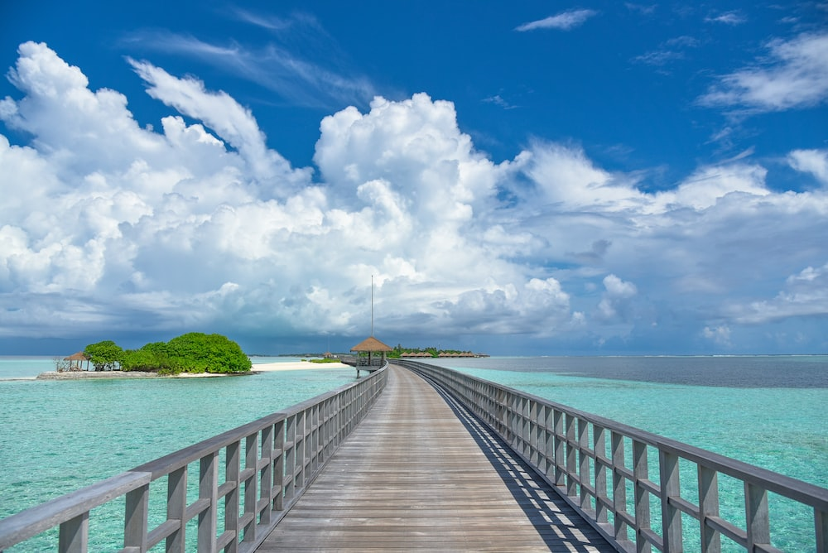
BUDGETING AND FUNDING TOURISM IN NIGERIA
PMI
Budgeting and funding is one of the most important financial habits to adopt in sustainable tourism.
In short, budgeting and funding are important because it helps the industry control their spending, track their expenses, and save more money.
Additionally, budgeting and funding can help make better financial decisions, prepare for emergencies, get out of debt, and stay focused on their long-term financial goals. Williams, D.R., (2001).

Slide 75

BUDGETING AND FUNDING TOURISM IN NIGERIA
PMI
Budget and funding are tools for sustainable tourism because of the following facts:
  It shows the industry where their money is going
  It helps the industry identify waste
  It helps the industry reach their goals
  It keeps the industry from accumulating too much debts
  It give the industry a clear picture of their finances
  It provides peace of mind for the managers of the industry.

Slide 76
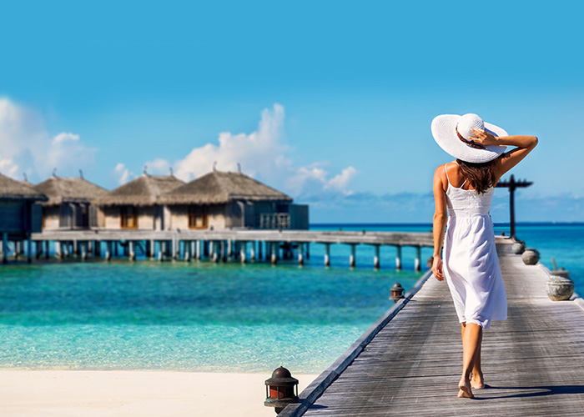
BUDGETING AND FUNDING TOURISM IN NIGERIA
PMI
Budgeting and funding helps the tourists and Tourism operators to control their spending.
Budgeting and funding keeps the industry on track for their financial goals.
Budgeting and funding can help capital project.
Budgeting and funding helps the industry find financial contentment.
Budgeting and funding keeps the industry feeling financially overwhelmed.

Slide 77
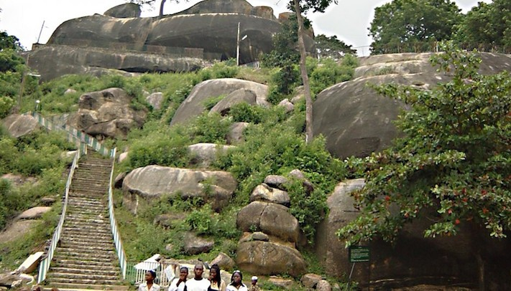
BUDGETING AND FUNDING TOURISM IN NIGERIA
PMI
Budgeting and funding help the industry avoid or get out of debt.
Budgeting and funding help the industry to be organized
budgeting and funding helps the industry prepare for emergencies
Budgeting and funding helps the industry save money.
Budgeting and funding helps the industry get (and stay) ahead.

Slide 78
BUDGETING AND FUNDING TOURISM IN NIGERIA
RECOMMENDATIONS FOR
TOURISM DEVELOPMENT IN NIGERIA

Slide 79
BUDGETING AND FUNDING TOURISM IN NIGERIA
PMI
Contribution of travel and tourism to GDP in Nigeria in 2019 and 2020 (in million U.S. dollars)
Characteristic | Contribution to GDP
2020 | 2.8%
2019 | 4.4%

Slide 80

BUDGETING AND FUNDING TOURISM IN NIGERIA
PMI
There must be strategic planning of the tourism industry in Nigeria – This is the development of priorities based on strategies for planning developing and marketing of Nigeria as tourist destination.
The plan must include the 7Ps of Tourism:
    Product
    Price
    Place
    Promotion
    Process
    Physical Evidence
    People.

Slide 81
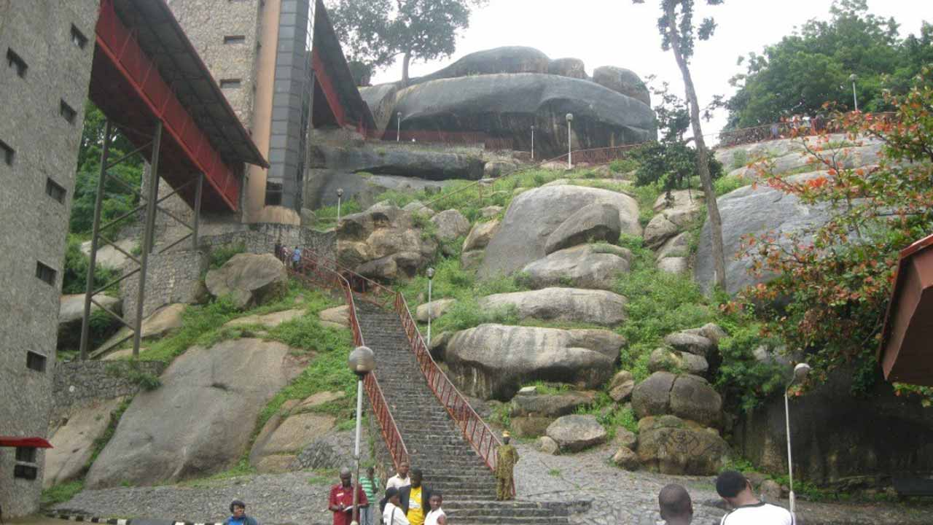
BUDGETING AND FUNDING TOURISM IN NIGERIA
PMI
Improvement in security situation in Nigeria and the creation of an enabling environment for rapid growth and development of tourism in Nigeria.
Government policies specifically targeted to tourism development in Nigeria

Slide 82
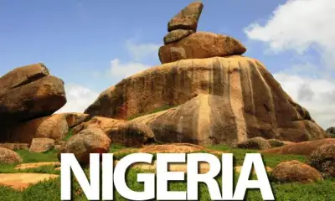
BUDGETING AND FUNDING TOURISM IN NIGERIA
PMI
Effective marketing of Nigeria as a tourism destination in Africa.
This Association (FTAN) must wake up to tap the Nigeria Government to come out of their share neglect of the tourism sector.

Slide 83
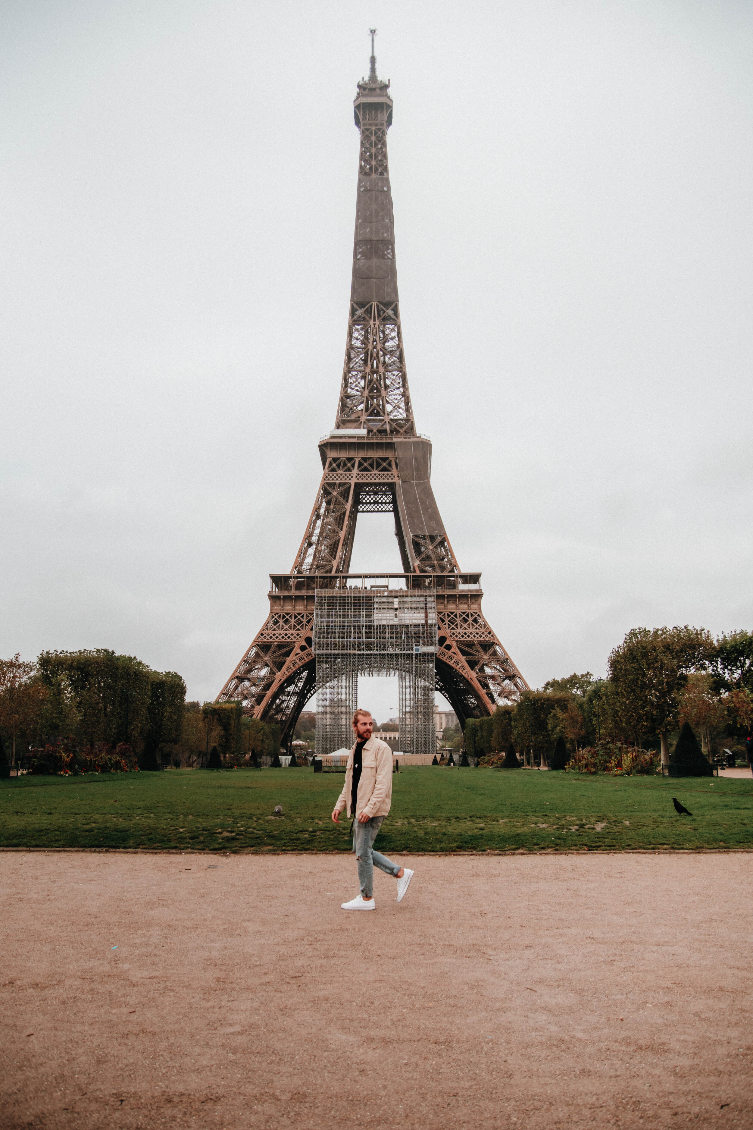
BUDGETING AND FUNDING TOURISM IN NIGERIA
PMI
Tourism Action Plan Committee - FTAN must set up a committee to plan actions for Engaging, Empowering and Enabling Tourism stakeholders in Nigeria toward reinventing the wheels of Tourism development in Nigeria. The Committee will:
    Develop a framework for tourism development through effective budgeting and funding of tourism activities in Nigeria.
    Develop budgeting and funding templates for tourism stakeholders in Nigeria.
    Develop a capacity building template for tourism budgeting and funding.

Slide 84
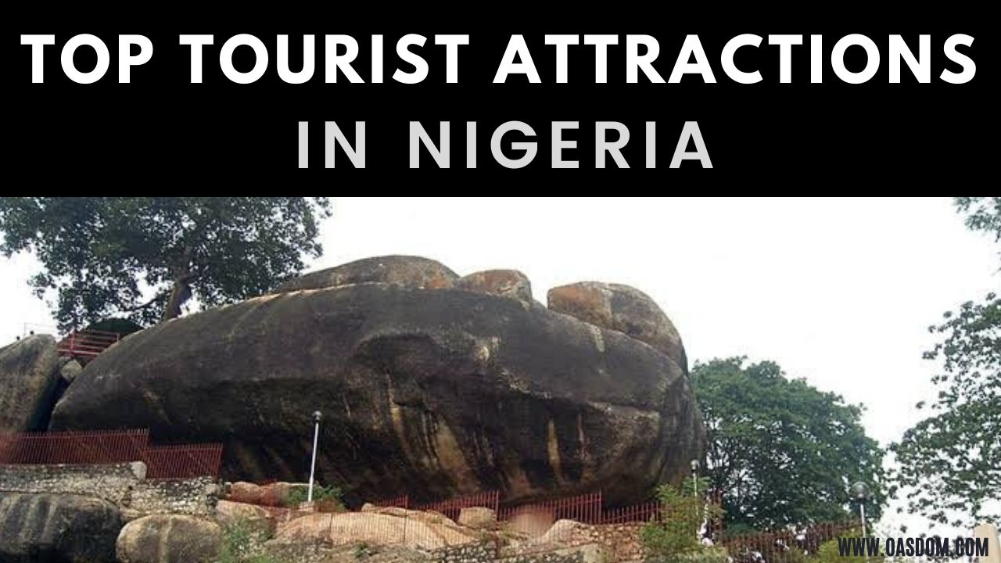
BUDGETING AND FUNDING TOURISM IN NIGERIA
PMI
Culture and Tourism can contribute significantly to the economic development of Nigeria if government will can:
    provide platform and enabling environment for the promotion and development of culture and tourism in Nigeria;
    Collaborate with the private sector (PPP Arrangements) to promote culture and tourism in Nigeria.
    Government should therefore increasing funding to tourism agencies and rejig their operations, so as to increase their contributions to National development.

Slide 85
BUDGETING AND FUNDING TOURISM IN NIGERIA
PMI
    Improve tourism infrastructures such as Roads, Rail, Energy, Waterways etc.
    Development and production of compendium of tourism sites and cultural festival calendars in Nigeria.
    Recognize FTAN as a Central Agency for the promotion and development of tourism in Nigeria.

Slide 86
BUDGETING AND FUNDING TOURISM IN NIGERIA
PMI
    All of the above can only be done if we good leaders in Government and in the various organizations operating within the Culture and Tourism sector of the Nigerian economy.
    What kind of leaders do we have in Nigeria?

Slide 87

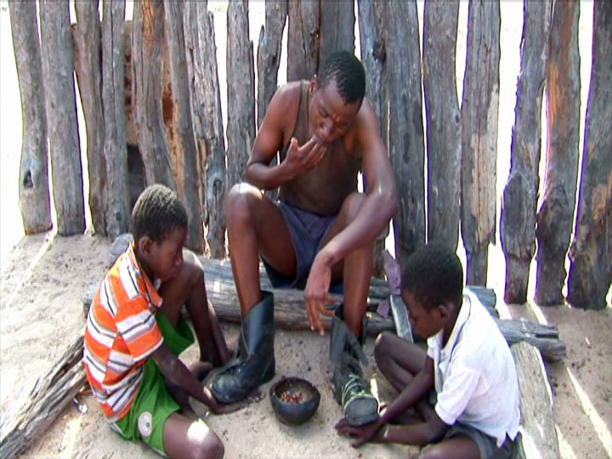
BUDGETING AND FUNDING TOURISM IN NIGERIA
PMI
AVOID
This is the main leadership problem in Nigeria today!

Slide 88
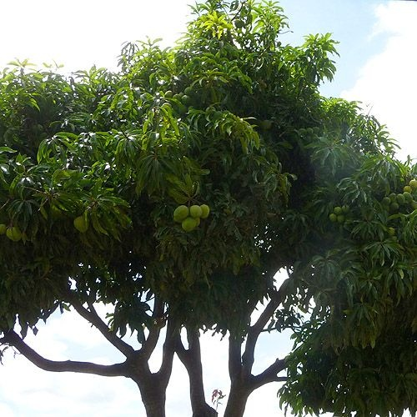
What is the name of this tree?

Slide 89
BUDGETING AND FUNDING TOURISM IN NIGERIA
What is the valued of a tree without the fruits?
A Tree:
      Provides – Fruits for others;
      Protects – Others and the environment; and
      Promotes (Attracts) – Others to self.
      These are the 3Ps of Leadership responsibilities in the Tourism sector in Nigeria
Notes:
89

Slide 90
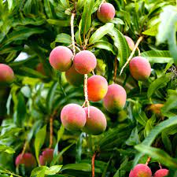
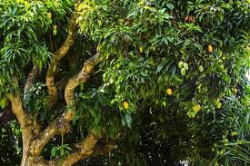
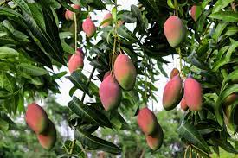
BUDGETING AND FUNDING TOURISM IN NIGERIA
SWEET FRUITS
BITTER FRUITS
WHICH OF THESE TREES WILL RECEIVE THE HIGHEST NUMBER OF STONES?
Notes:
90

Slide 91
BUDGETING AND FUNDING TOURISM IN NIGERIA
CONCLUSION

Slide 92
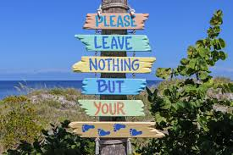
BUDGETING AND FUNDING TOURISM IN NIGERIA
PMI
Therefore, budgeting and funding is one of the most important financial habits the industry can adopt, to improve it currently dismay performance.
Between helping the industry achieve their financial goals, keeping the industry from getting financially overwhelmed, and even helping them avoid or get out of debt, there are so many reasons to live one budget.

Slide 93


BUDGETING AND FUNDING TOURISM IN NIGERIA
THE TOURISM SECTOR IS LIKEA POT WITH HOLES
THE POT IS TO BE FILLED WITH WATER
Nig. Hotel Ass.
Other Stakeholders
Nig. Tourist Ass.
Travel Agencies
Airlines and Train
TIEZA
Tour Operators
General Tourism Staff
FTAN
Nigeria Tourism Development Corporation

Slide 94
BUDGETING AND FUNDING TOURISM IN NIGERIA
PMI
Nigeria has a great potential in the Tourism Sector and the time to take positive steps in the right direction is NOW.
Ladies and Gentlemen, The ball is firmly in your court!!!

Slide 95



Young boy who wants to know his future from an old man fortune teller.

Slide 96

APPRECIATION
Thank You

